Slide 1
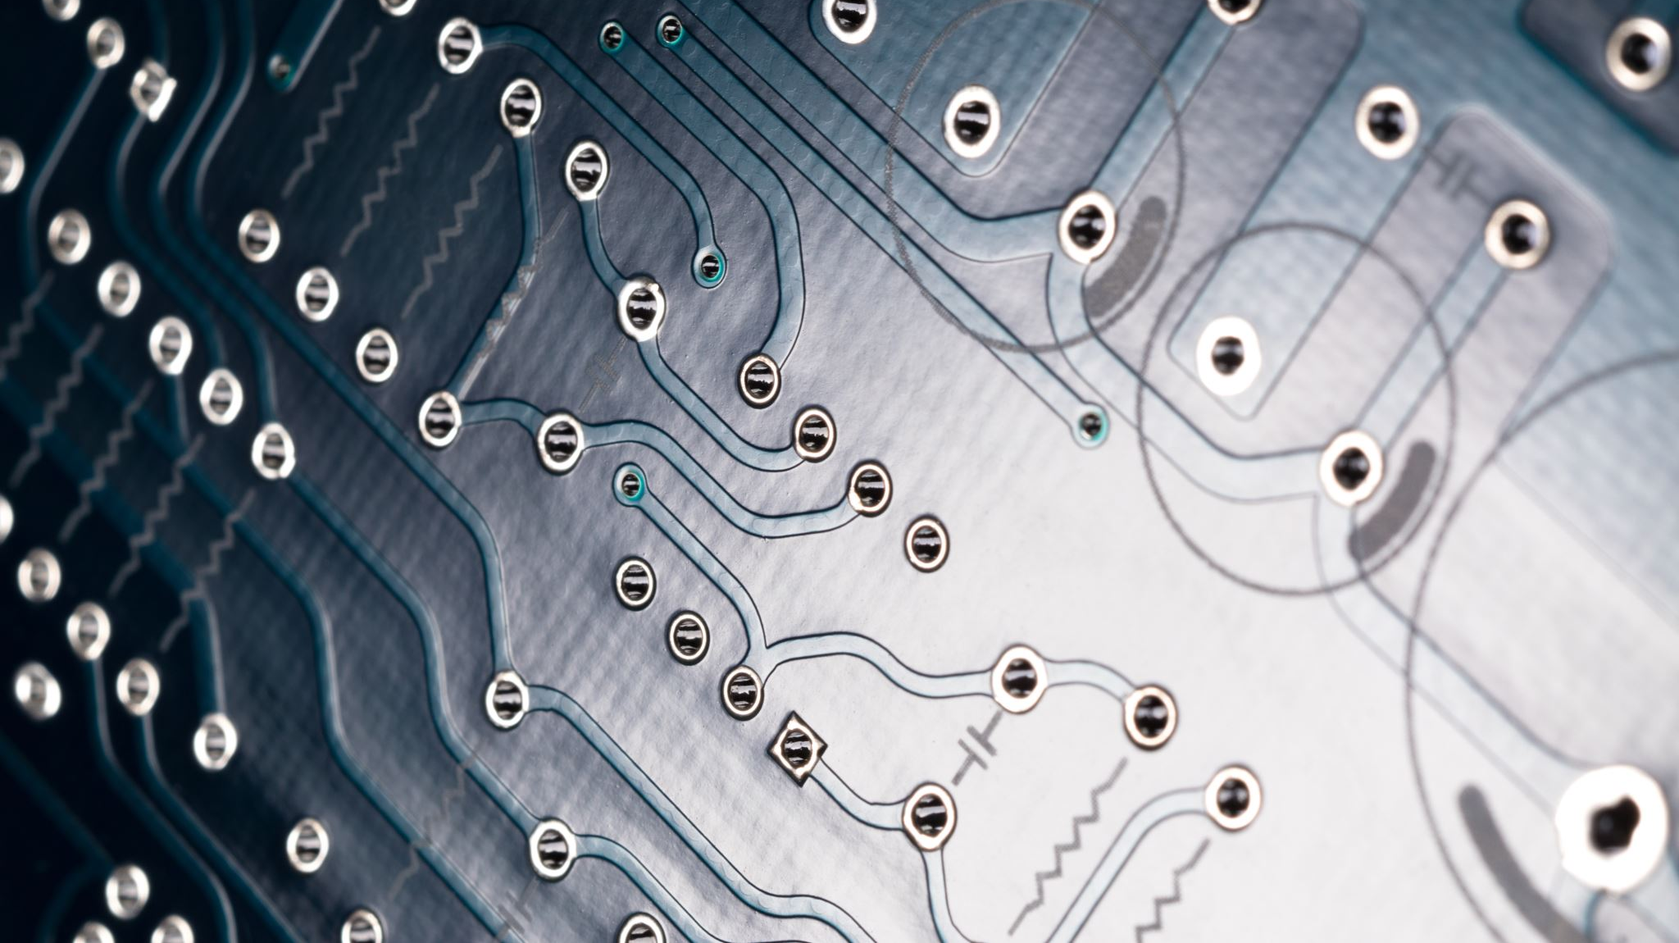
Embedded Systems
Using the BBC Microbit

Slide 2
What is an Embedded System
An embedded system is a small computer that forms part of a larger system, device or machine. Its purpose is to control the device and to allow a user to interact with it. They tend to have one, or a limited number of tasks that they can perform.
The BBC Microbit is an example of an embedded system

Slide 3
Examples of Embedded System
Examples of embedded systems include:
central heating systems
engine management systems in vehicles
domestic appliances, such as dishwashers, TVs and digital phones
digital watches
electronic calculators
GPS systems
fitness trackers

Slide 4
Programming the micro:bit
The microbit can be programmed in several languages, including python.
The easiest way to get started is to use the online microbit IDE (Integrated development environment) called Makecode editor and its available at makecode.microbit.org

Slide 5
What is a micro:bit
Battery pack
Micro-USB cable
micro:bit

Slide 6
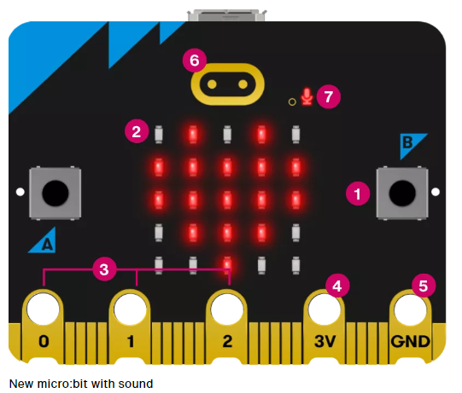
What is a micro:bit (front)
1 – A and B buttons
2 – LED display and light sensor
3 – Pins GBIO
4 – Pin 3 volt power
5 – Pin Ground
6 – Touch logo
7 – Microphone LED

Slide 7
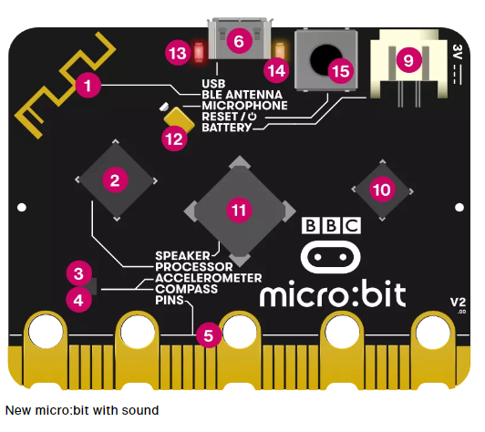
What is a micro:bit (back)
1 – Radio and Bluetooth antenna
2 – Processor & Temperature Sensor
3 – Compass
4 – Accelerometer
5 – Pins
6 – Micro USB socket
9 – Battery Socket
10 – USB Interface chip
11 – Speaker
12 – Microphone
13 – Red power LED
14 – Yellow USB LED
15 – Reset & Power button

Slide 8
Microbit Sensors
Accelerometer – a motion sensor that measures movement. The accelerometer in your BBC micro:bit detects when you tilt it left to right, backwards and forwards and up and down.
Temperature Sensor - An input device that measures temperature. The temperature sensor is inside the processor which can give you an approximation of the air temperature.
Light Sensor - An input device that measures light levels. Your micro:bit uses the LEDs to sense the levels of light.

Slide 9
Microbit Sensors
Compass – The compass is an input sensor that detects magnetic fields. The micro:bit has an inbuilt compass that can detect the direction in which it is facing.
Touch Logo - The touch logo uses capacitive touch, sensing tiny changes in electrical fields to know when your finger is pressing it - just like your phone or tablet screen.
Microphone - The micro:bit has a built-in microphone. You can use it as a simple input - make your micro:bit turn the lights on when you clap. It can measure the amount of sound

Slide 10
Microbit Sensors
Radio - Radio is a way of sending and receiving messages and BBC micro:bits can use radio waves to communicate with each other.
Pins - On the bottom edge of the micro:bit there are 25 gold strips, called pins. These pins allow you create circuits or connect external things like buzzers and motors
Buttons - Buttons are a very common input device. Your micro:bit has two buttons you can program, and a reset button

Slide 11
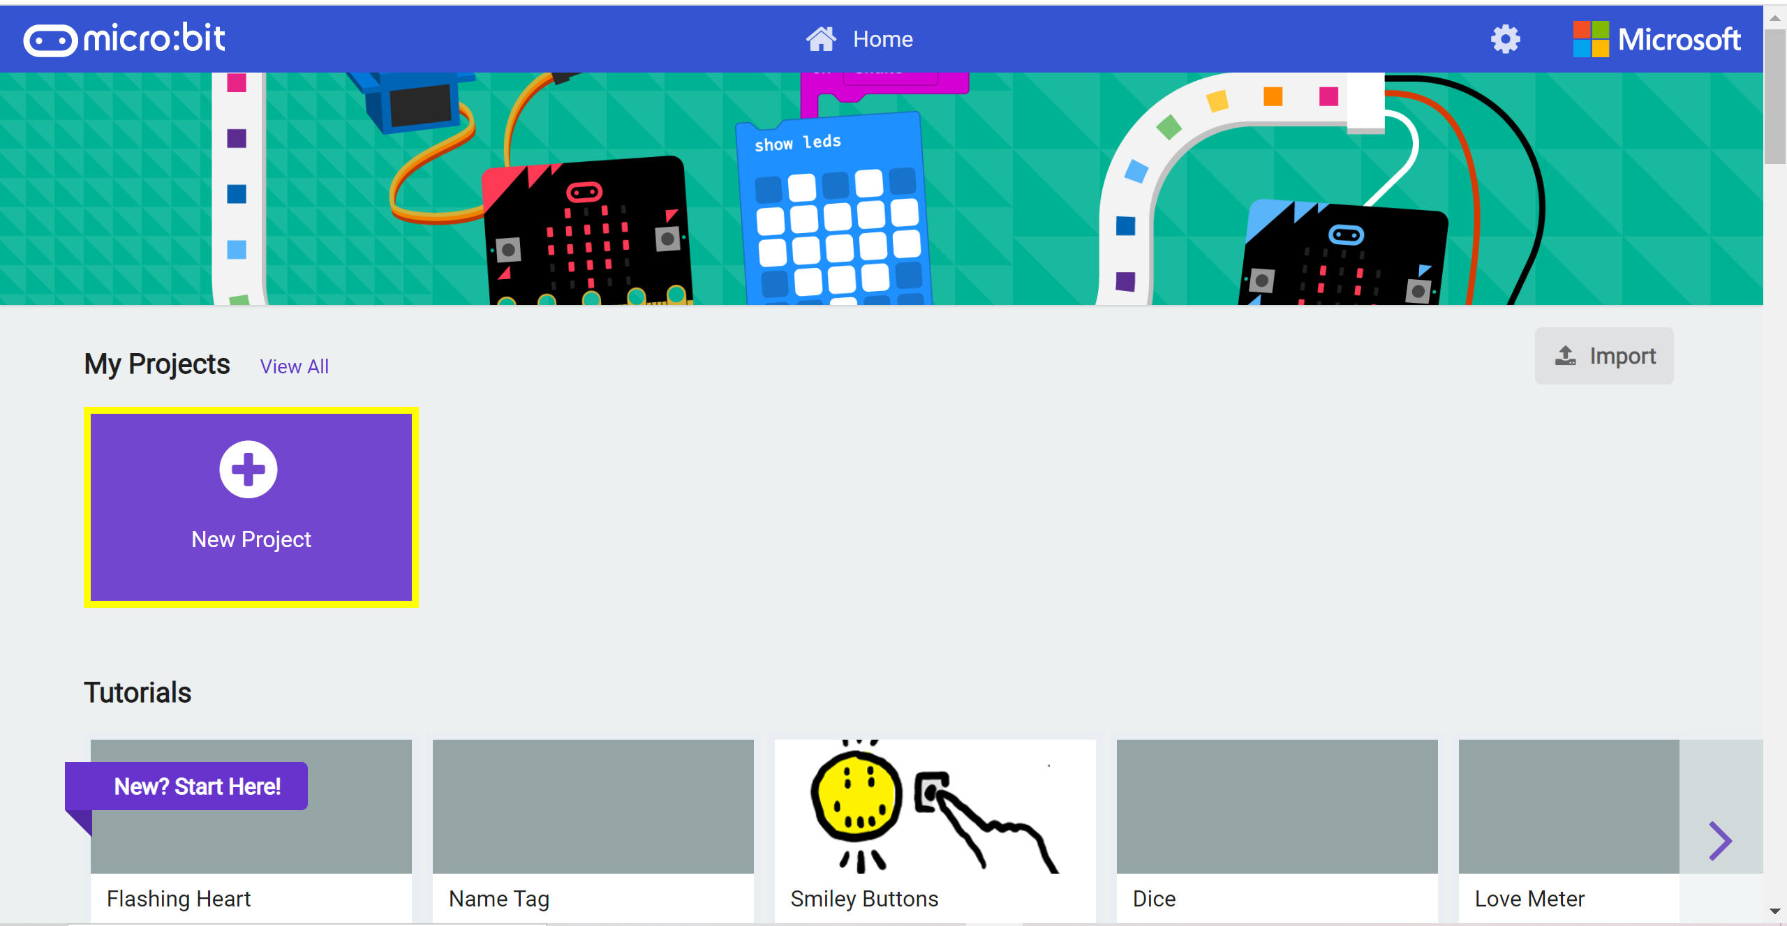
Microsoft MakeCode
Go to https://makecode.microbit.org and click on New Project

Slide 12
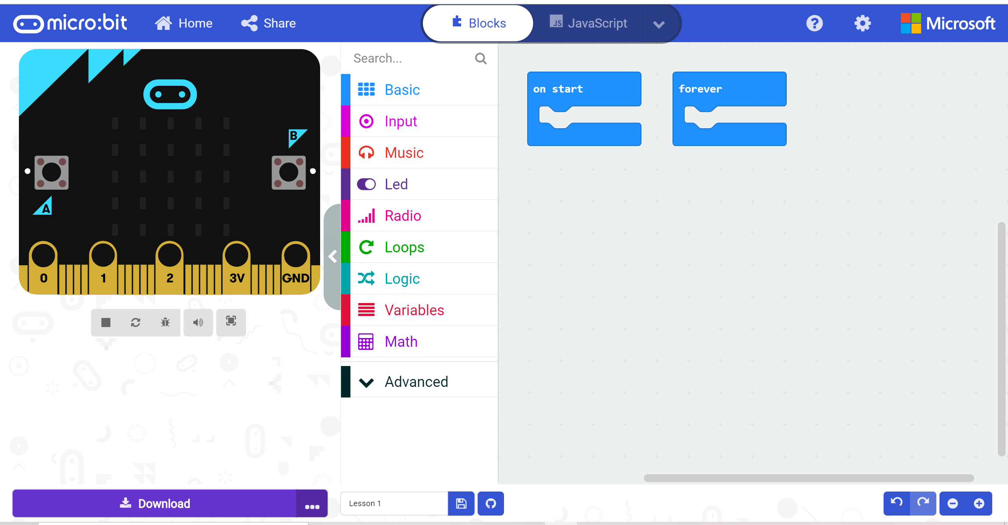
Microsoft MakeCode Editor
Simulator
Workspace
Toolbox

Slide 13
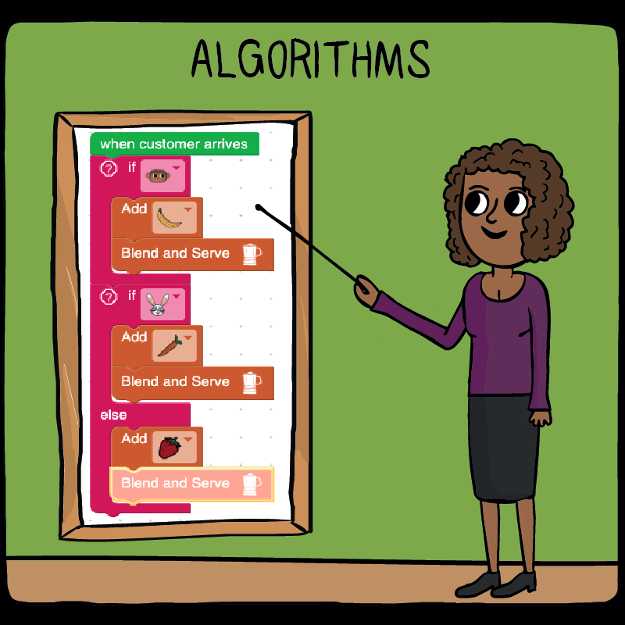
Algorithms
An algorithm is a sequence of instructions or a set of rules to get something done.
Computer scientists strive for algorithms which solve problems in the most-effective and efficient ways – getting the most-accurate results, in the quickest time, with the fewest resources (memory or time).
Image Source: codemonkey.com

Slide 14
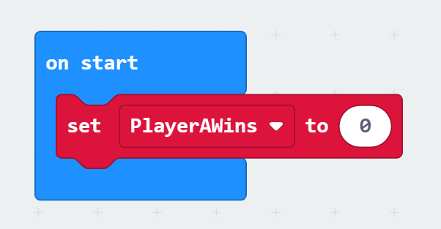
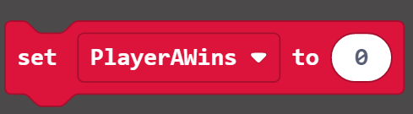
Variables
> What is a variable?
A variable is a place where you can store and retrieve data.
Here’s how to define a variable in the Block Editor:
1. From the Variables Toolbox category select ‘Make
a Variable’ and give your variable a name.
2. Drag the and place it inside the
on start bracket.

Slide 15
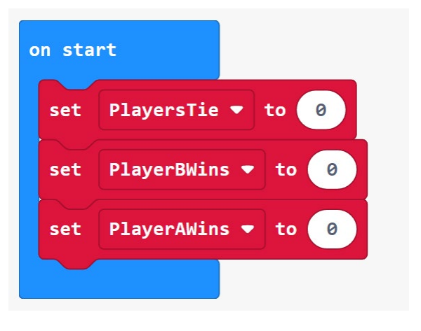
Variables (contd)
Complete the following blocks of code and initialise each variable to the value of 0 at the start of the programme.

Slide 16
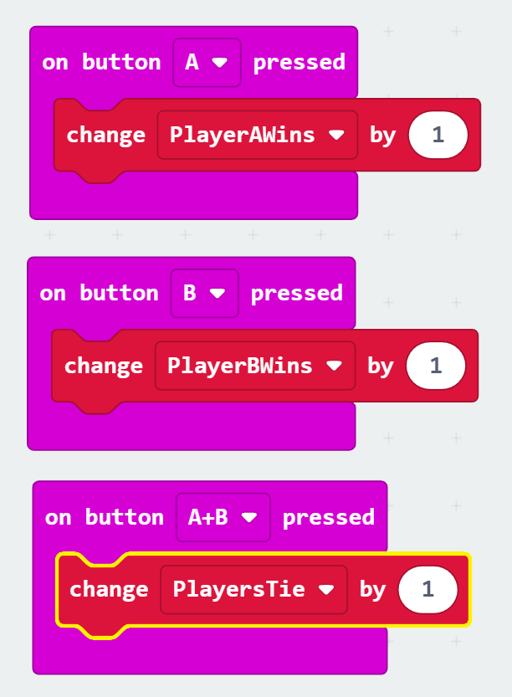
Variables (contd)
> We need to code to update the values at each round of the game.
Each time the scorekeeper presses button A to record a win for Player A, we want to add 1 to the current value of the variable PlayerAWins.
We want the same to happen when button B is pressed and also for when button A and B are pressed at the same time.

Slide 17
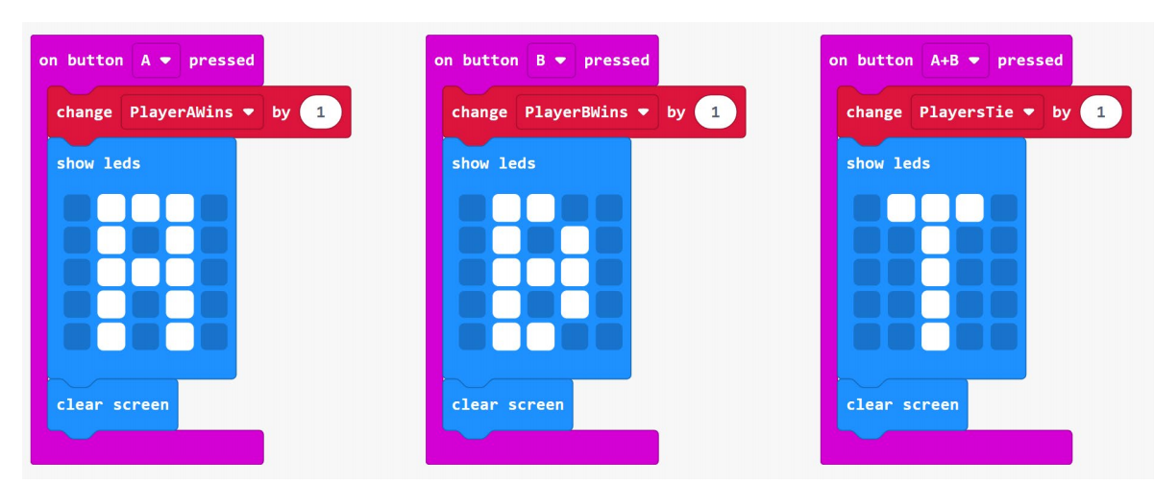
Basic Toolbox Category
We can code our programme to display an ‘A’, ‘B’ or ‘T’ using the show leds block.
This will give the user visual feedback acknowledging that the user pressed a button.
Notice that we added a clear screen block after showing ‘A’, ‘B’, or ‘T’.

Slide 18
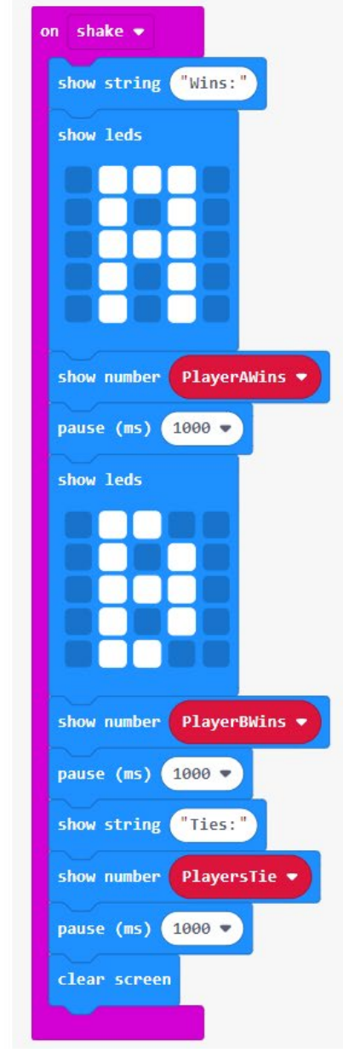
Display Final Variable Values
Drag out the on shake event handler block from the Input Toolbox category to trigger this event.
Add the show string show number pause show leds and clear screen blocks from the Basic Toolbox category and insert them into the on shake bracket as shown.
In the Variables Toolbox category drag out the curved variable name blocks and insert them in the corresponding show number blocks to activate them.

Slide 19
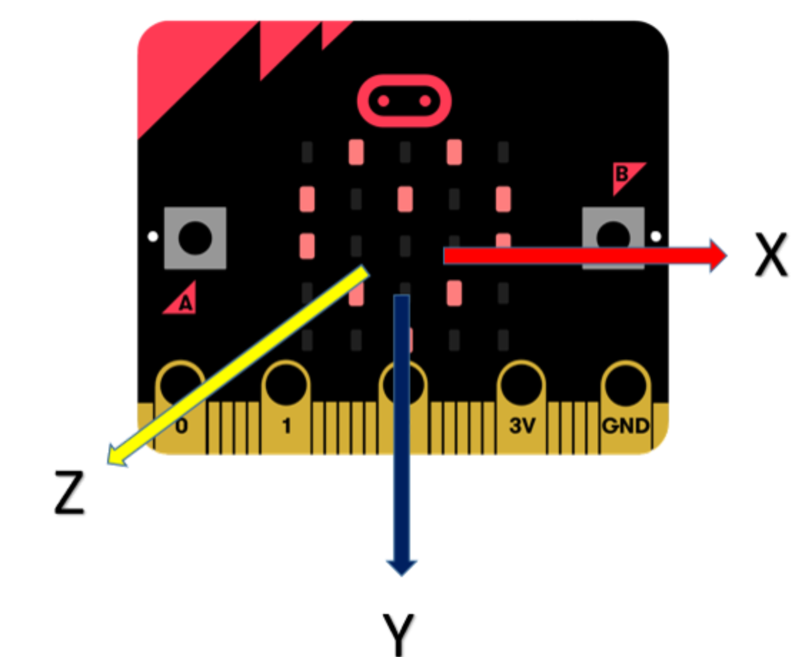
Accelerometer
The micro:bit contains an accelerometer sensor that is able to measure forces applied to the board. On earth, we are subject to the gravity force which pulls us to the ground!
When the micro:bit is flat on a table, with the screen pointing up, the gravity force is aligned with the Z axis of the micro:bit.
If you tilt it up and down, the force will align with the Y axis – this is how we can detect tilting. If the force along Y grows, the micro:bit is tilting more and more vertically.

Slide 20
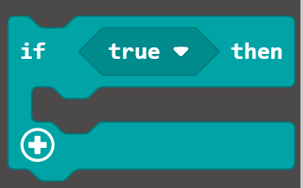
Conditionals
> What is a condition?
A condition is criteria that the user must meet for a certain function to be carried out.
> Why use a condition?
We can add a condition to make code function in certain ways:
A calculator waits for the user in input numbers and a function, before outputting a result
A game waits for the user to press a button at the right time before outputting their score
A quiz waits for the user to choose the correct option, and if they are wrong the quiz will tell the user

Slide 21
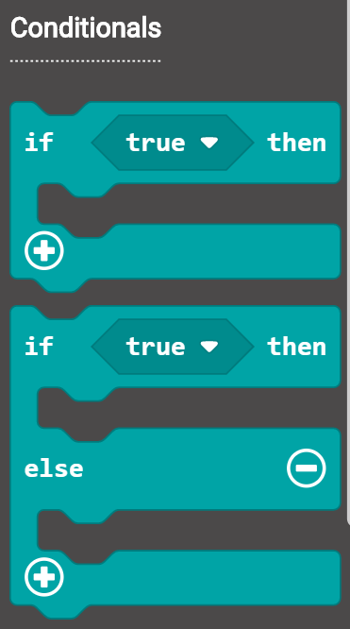
Conditionals (Contd)
The code inside the if block only runs when the condition block is true. You can compare variables to values or variables to variables, for a true condition.
If you want some other code to run when the opposite condition is true, you put it in an additional block area called else.

Slide 22
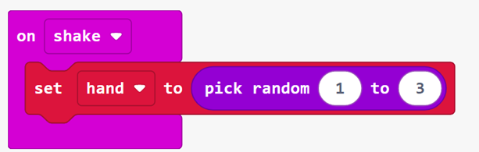
Block Code
> Create this programme
Add an on shake block from the Input Toolbox category to run code when you shake the micro:bit
Create a variable called ‘hand’ and place the set hand to block in the shake event.
Add a pick random block from the Math Toolbox category to pick a random number from 1 to 3 and store it in the variable named ‘hand’.

Slide 23
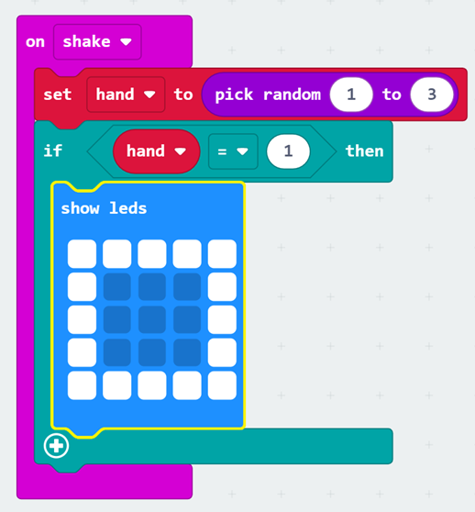
Block Code
> Create this programme
Place an if block form the Logic Toolbox category under the pick random and check whether ‘hand’ is equal to 1.
Add a show leds block from the Basic Toolbox category that shows a picture of a piece of paper. The number 1 will mean paper.

Slide 24
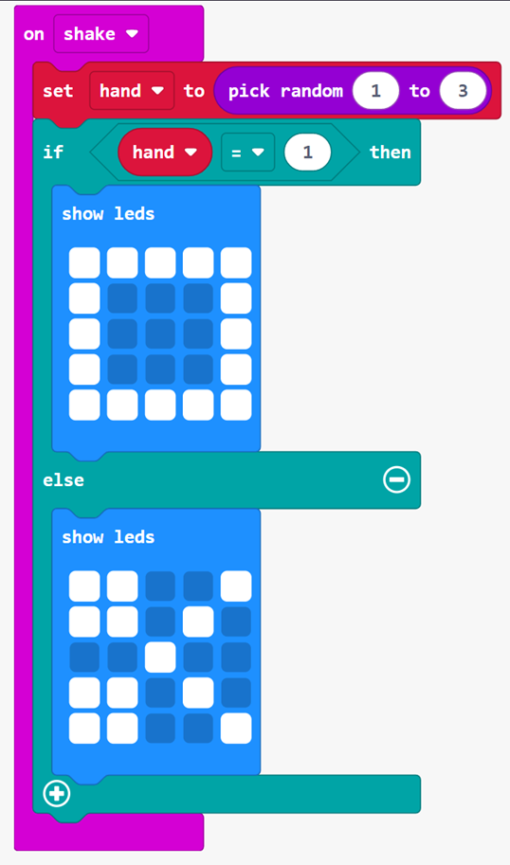
Block Code
> Create this programme
Click the (+) button to add an else section.
Add a show leds block inside the else. Make a picture of a scissors in the LEDs.

Slide 25
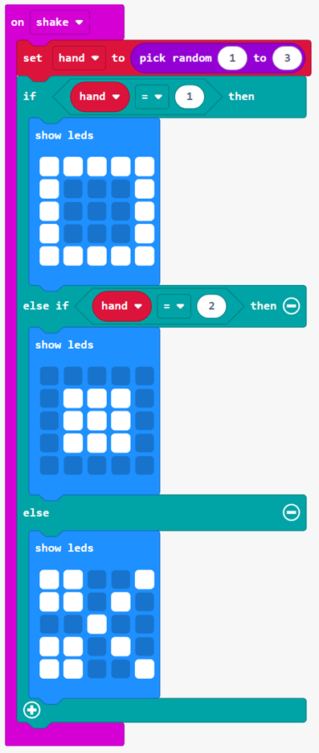
Block Code
> Create this programme
Click the (+) button again to add an else if section.
Now, add a conditional block for hand = 2 to the condition in else if. Since ‘hand’ can only be 1, 2, or 3, your code is covering all possible cases.
Get one more show leds block and put it in the else if. Make a picture of a rock in the LEDs.

Slide 26
Block Code
> Challenge A
Can you code Button A to act as a scoreboard?
> Challenge B
Modify the game to use different images or to add more options like ‘Rock Paper Scissors Skull Ghost’.

Slide 27
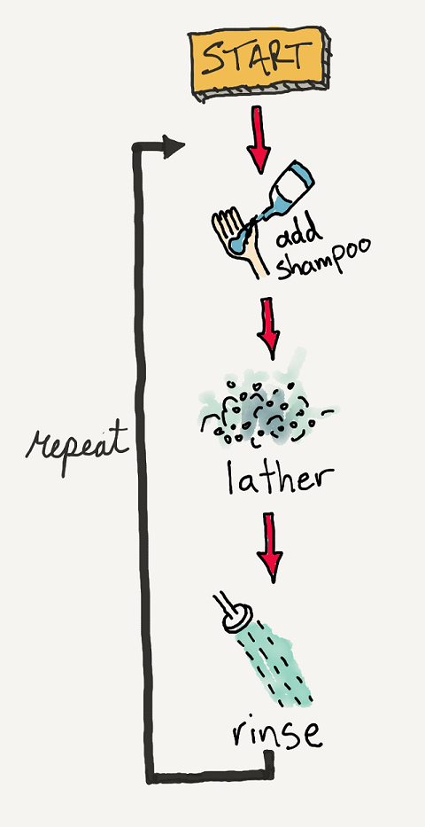
Iterations
> What is iteration?
Iteration (or a loop) is the process of repeating steps.
> Why use iterations?
Iteration allows us to simplify our algorithm by stating that
we will repeat certain steps until told otherwise.
This makes designing algorithms quicker and simpler because
they don’t have to include lots of unnecessary steps.
Image source: makecode.microbit.org

Slide 28
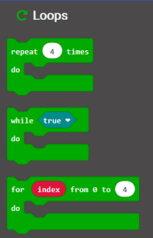
Iterations (Contd)
Microsoft MakeCode has three different loop blocks: Repeat block
While block
For block
You’ll notice that the repeat block takes a parameter. The parameter tells the repeat block how many times we want the code within the block to repeat.

Slide 29
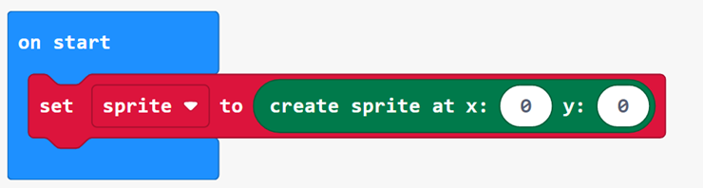
Block Code
> Create this programme
Create a variable called ‘sprite’ and place the set sprite to block in the on start event handler.
Click on the ‘advanced’ option in the toolbox category and scroll down to the game tab.
Add a create sprite at x:0 y:0 block from the and store it in the parameter of the set sprite to block.

Slide 30
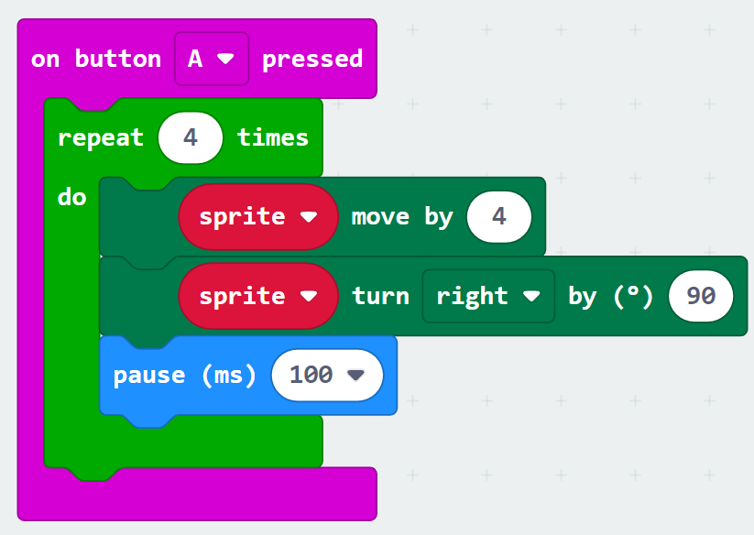
Block Code
> Create this programme
From the input toolbox category drag out an on button A pressed block to your workspace.
In the loops toolbox category select the repeat block and leave the parameter at 4. Place this block inside the on button A pressed block.
In the game toolbox category drag out sprite move by block and change the parameter to 4. Also drag out the sprite turn right by block and change the parameter to 90. Place both these blocks inside the repeat block.

Slide 31
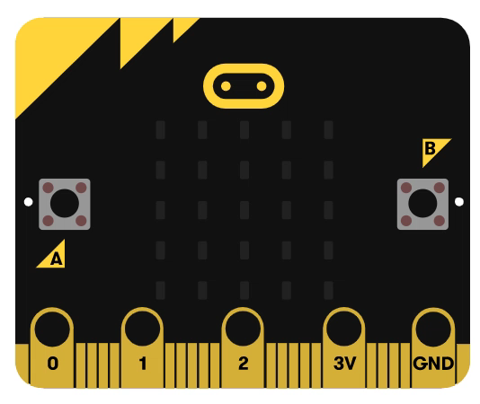
Block Code
> Challenge
Using a For Loop try and make an led light move across the entire display from left to right, top row to bottom row.

Slide 32
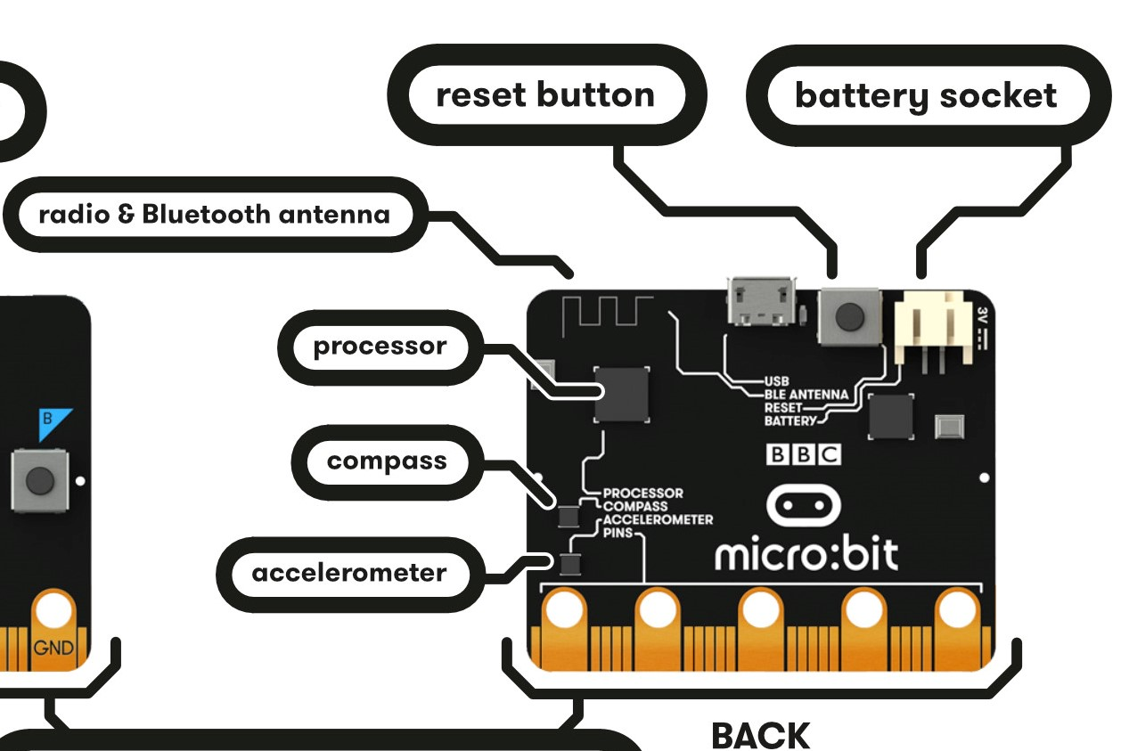
Radio in the micro:bit
The micro:bit allows you to communicate with other micro:bits in the area using the blocks in the Radio category. You can send a number, a string (a word or series of characters) or a string/number combination in a radio packet via a Bluetooth radio. You can also give a micro:bit instructions on what to do when it receives a radio packet.
Image source: makecode.microbit.org

Slide 33
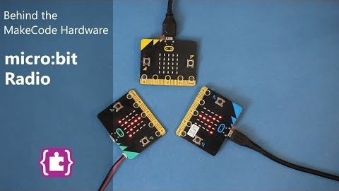
Radio in the micro:bit (Contd)
Watch this video to see how the radio hardware works on the micro:bit.
Video source: makecode.microbit.org

Slide 34
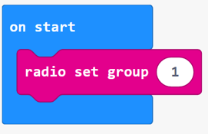
Block Code
> Create this programme
From the Radio menu, drag a ‘radio set group’ block to the coding workspace and place the block into the on start block.
In the ‘radio set group block’, leave the default value of 1 for the group ID.

Slide 35
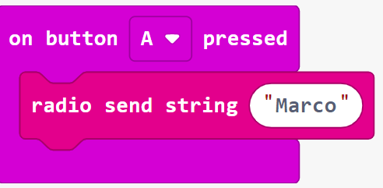
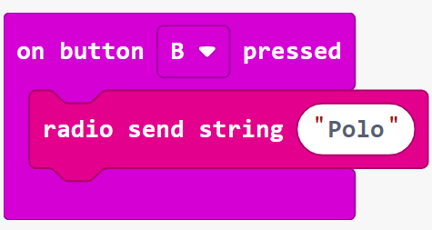
Block Code
> Create this programme
Drag 2 ‘on button pressed’ blocks to the coding workspace. Leave one with the default value A and change the other button to B.
From the Radio Toolbox drawer, drag 2 ‘radio send string’ blocks to the coding workspace. Place one into the ‘on button A pressed’ block, and the other into the ‘on button B pressed’ block.
In the ‘on button A pressed’ block, change the default empty string value of the ‘radio send string’ block to the string “Marco”.
In the ‘on button B pressed’ block, change the default empty string value of the ‘radio send string’ block to the string “Polo”.

Slide 36
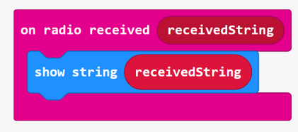
Block Code
> Create this programme
To display the data sent between the micro:bits, drag an ‘on radio received receivedString’ block to the coding workspace.
From the Basic Toolbox drawer, drag a ‘show string’ block into the ‘on radio received receivedString’ block.
From the ‘on radio received receivedString’ block, drag the ‘receivedString’ variable block into the default string value of “Hello” in the ‘show string’ block.

Slide 37
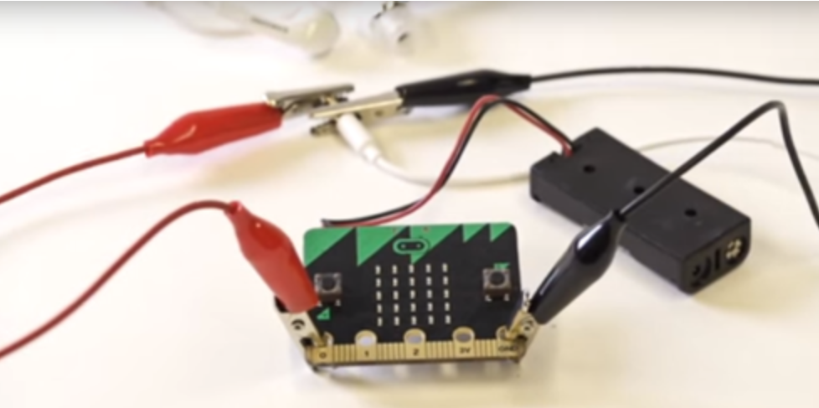
Block Code
> Challenge
Add a ‘show leds’ block to the ‘on start’ block. (We created an image of the initials MP.)
From the Music Toolbox drawer, drag 2 ‘play tone’ blocks to the coding workspace.
Drag one of the ‘play tone’ blocks to the ‘on button A pressed’ block, and the other one to the ‘on button B pressed’ block.
Change the default value in the ‘play tone’ block that is inside the ‘on button A pressed’ block to the value Low C.
How to connect headphones to your micro:bit
Image source: makecode.microbit.org

